Slide 1
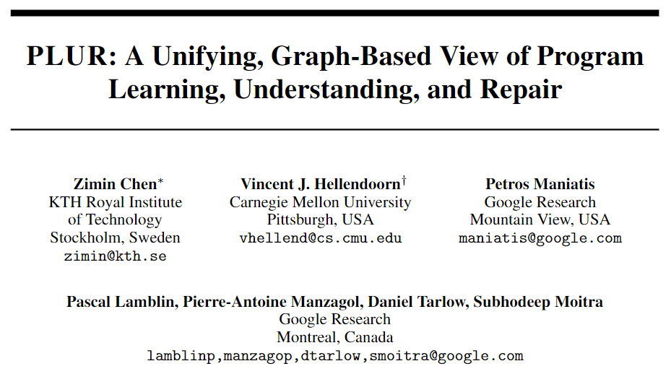
NeurIPS 2021 Spotlight

Slide 2
Motivation
Text2text provides a simplifying and unifying view in NLP.
What is the equivalent unifying abstraction for ML4code?
Graph2ToCoPo, which pairs a graph encoder and a Transformer-style sequence decoder augmented with pointers and a copy mechanism, has been shown to be effective for certain ML4code tasks.
We propose use Graph2ToCoPo as the unifying abstraction.

Slide 3
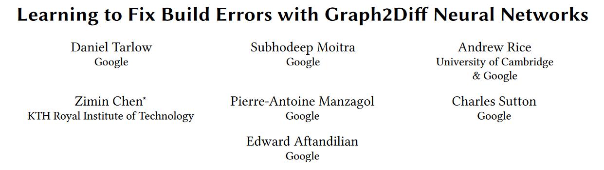
Graph2ToCoPo
arXiv 1911.01205, cited by 28 papers
Probably rejected, finally printed in an ICSE workshop in 2 pages

Slide 4
Graph2ToCoPo
Input: a directed multi-graph with node types, node values, node indices and edge types; the graph can include different information for different tasks.
Output: a sequence of either token, copy expression or pointer.
Problem: automatic repair of build errors, e.g. unresolved symbols, type errors, and incorrect build dependencies.
How to abstract this problem as Graph2ToCoPo:
Input: code subgraph (AST) + diagnostic subgraphs (diagnostic kind + tokens of diagnostic message + the code token in diagnostic message + a diagnostic root node) + BUILD file subgraph (an XML-style document treated as a tree) with edges representing AST child, next node, next lexical use, diagnostic location and diagnostic argument.
Output: an DSL that describes the repair as a diff.
Actual network: GGNN encoder, transformer decoder with pointer.

Slide 5
PLUR: Program Learning, Understanding, and Repair
Model: GREAT encoder and Transformer decoder.
GGNN encoder and Transformer encoder are also tested.
Exact information contained in the input and the format of output is specified by each task.
The goal is to prove that the framework is general enough, so new architecture is on purpose not proposed.

Slide 6
PLUR tasks
model/dataset | task | input | output | metric
ManySStuBs4J | bug type classification | token sequence | the class as a token | accuracy
code2seq | method name prediction | a set of AST paths between identifiers | subtokens of method name | F1
funcom | summarization | token chain | subtokens of docstring | BLEU
VarMisuseH | localization and repair | input is a graph | a pointer to the bug location, a token of correct variable | localization and repair accuracy
Hoppity | bug repair in a corpus of ASTs | input is a graph | transformation type, a pointer and others | repair sequence accuracy
convattn | method name prediction | token chain | subtokens of method name | F1
ogb-code | method name prediction | input is a graph | tokens of method name | F1
CuBERT | many tasks | subtoken chain | the result as a token | many metrics
Retrieve & Edit | completion with context | token chain of contexts | tokens | avg and max of correctly predicted successive tokens

Slide 7
Tasks and datasets: code2seq
Method name prediction.
Input: a set of AST paths between identifiers.
Output: a sequence of subtokens constituting the method name.
Metric: F1 score.

Slide 8
Tasks and datasets: convattn
Method name prediction.
Input: a token chain.
Output: a sequence of subtokens constituting the method name.
Metric: F1 score.

Slide 9
Tasks and datasets: ogb-code
Method name prediction.
Input: the original input is already a graph.
Output: method-name tokens.
Metric: F1 score.

Slide 10
Tasks and datasets: funcom
Method summarization.
Input: a token chain.
Output: a sequence of subtokens constituting the docstring.
Metric: BLEU scores.

Slide 11
Tasks and datasets: CuBERT
Six Python-based tasks defined on Py150.
Exception classification (EC): predict the exception type in a try/except clause.
Wrong Operator Classification (WB): predict if the function uses a wrong operator.
Swapped Operand Classification (SO): predict if a non-commutative operator's arguments are swapped.
Function-Docstring Classification (FD): predict if a docstring matches a function body.
Variable Misuse Localization and Repair (VMR): localize and repair a variable misuse bug.
Input: a sequence of subtokens.
Output: a token for classification tasks, and a pointer to the bug, along with correct variable for VMR.
Metric: accuracy for classification tasks, localization and repair accuracy for VMR.

Slide 12
Tasks and datasets: ManySStuBs4J
Classification of a Java function to a number of bug types or as bug-free.
Input: a token sequence.
Output: the class as a token.
Metric: classification accuracy.

Slide 13
Tasks and datasets: VarMisuseH
Localization and repair of a Python variable-misuse bug.
Input: the original input is already a graph.
Output: a pointer to the bug location and a token of the correct variable; or a special token for a bug-free example.
Metric: localization and repair accuracy.

Slide 14
Tasks and datasets: Hoppity
Repair of bugs in a corpus of ASTs, and repairs are AST modifications.
Input: the original input is already a graph.
Output: the transformation type (as a token), a pointer to the AST node to transform, and other pointers or tokens depending on the transformation type.
Metric: repair sequence accuracy.

Slide 15
Tasks and datasets: Retrieve & Edit
Complete a Python function given the block comment, function name and arguments.
Retrieval results not used.
Input: block comment, function name, arguments as separate token chains, and they are all connected to a root node.
Output: a sequence of function tokens.
Metric: correctly predicted average and maximum number of successive tokens.

Slide 16
PLUR Framework: how to use?
As an evaluation suite to compare different models.
As an interface for new tasks.
Different encoding variants of code2seq can be compared with the same model.
As a unified view for multitask learning.
A new task, CuBERT-MT, by adding an extra node to each example with a new type and the task as a label, keeping the output unchanged, and combining all examples into one dataset.

Slide 17
Experiments
Research Questions:
How does the general PLUR approach compare to approaches like GREAT, Hoppity, and code2seq?
How do encoders based on the Transformer, GREAT, and GGNN compare across the PLUR benchmark?
How important are copy mechanisms? How important are pointers to specify locations?
What is the effect of different graph representations?
Does multitask learning provide improvements?

Slide 18
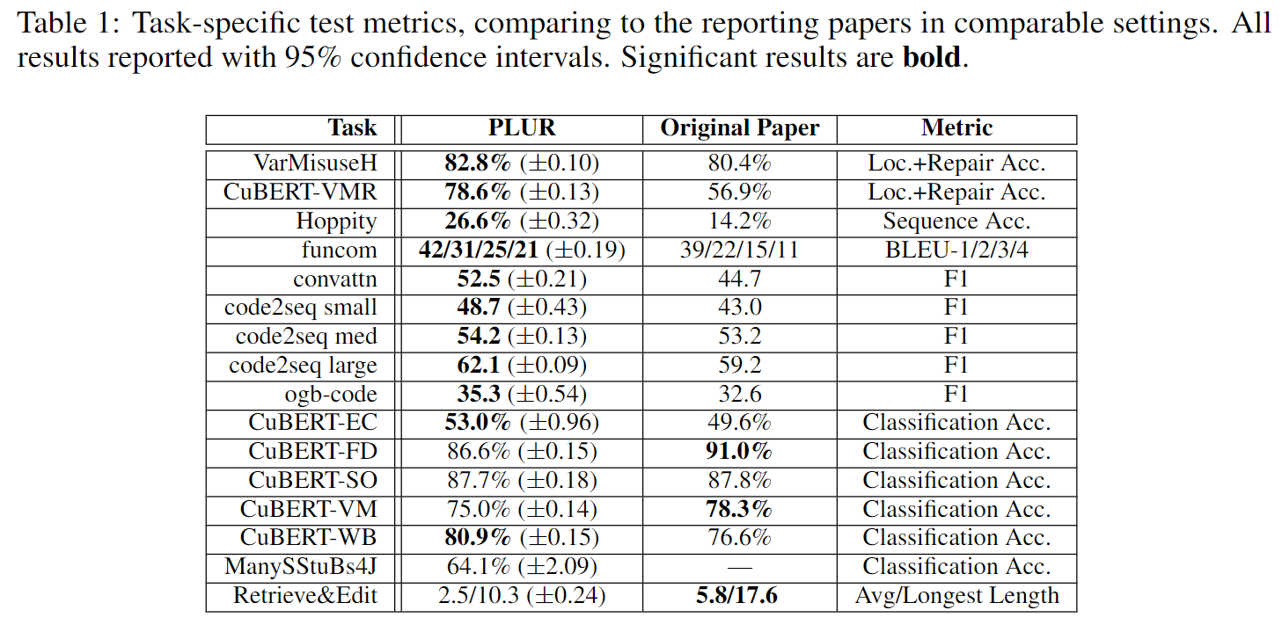
RQ1: How does PLUR approach perform?

Slide 19
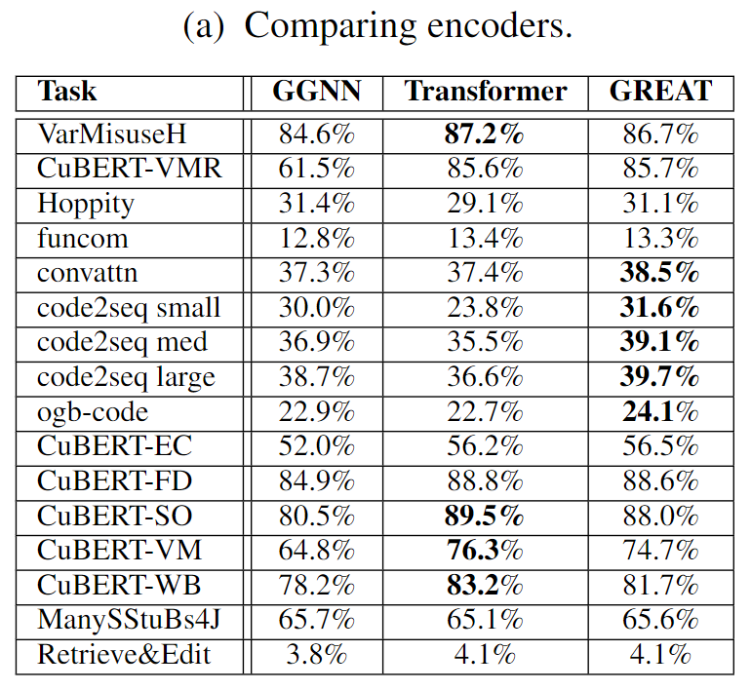
RQ2: How do encoders perform?

Slide 20
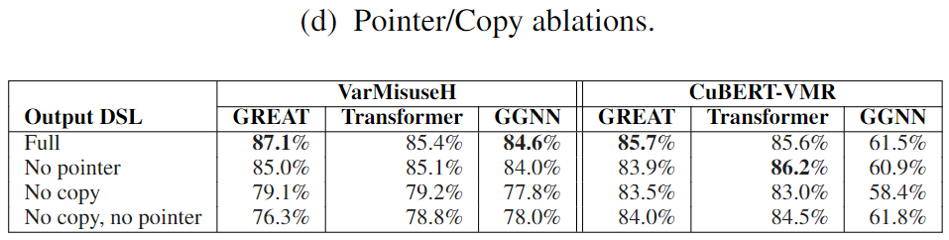
RQ3: How important are copy and pointers?

Slide 21
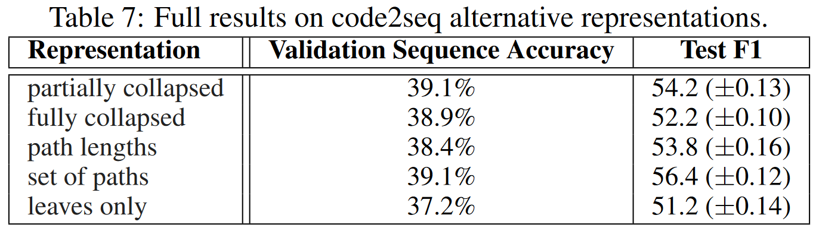
RQ4: What is the effect of graph encodings?

Slide 22
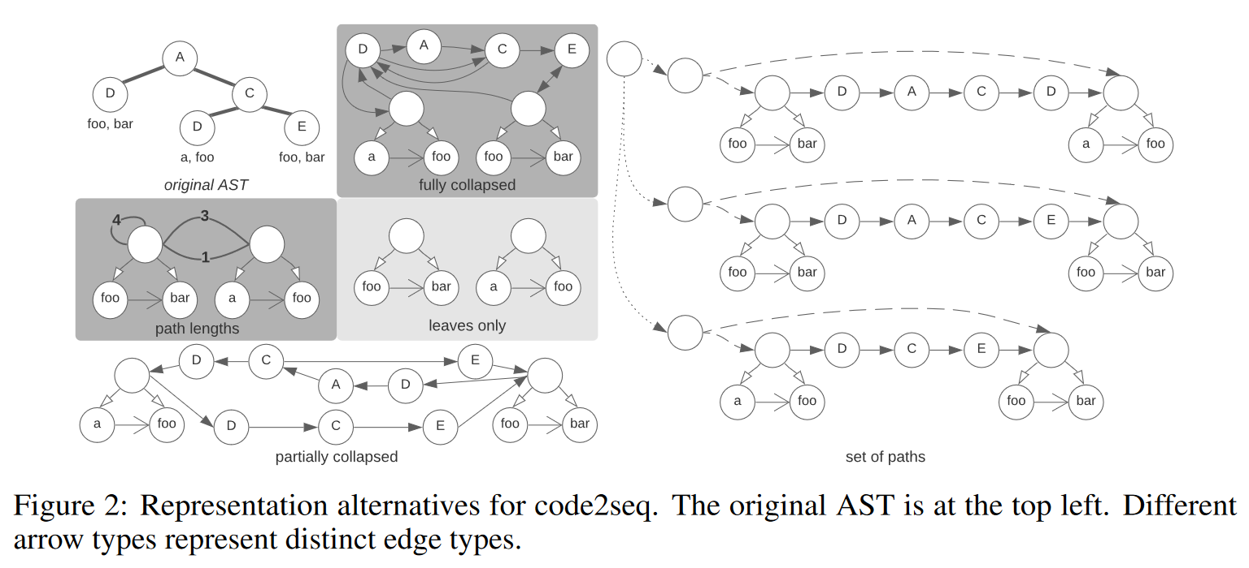
Different variants of code2seq

Slide 23
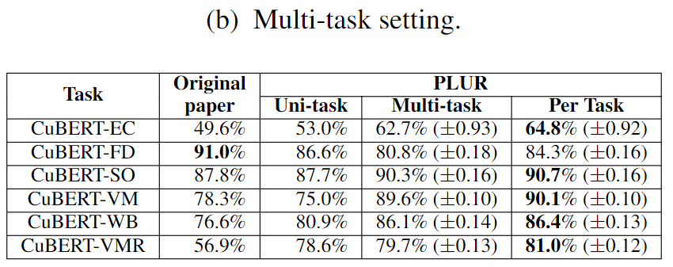
RQ5: does multi-task learning provide improvement?

Slide 24
Conclusion
PLUR provides a powerful and unifying model for different tasks in ML4code.
Experiments show that PLUR can achieve state-or-the-art results on several ML4code tasks.
Several interesting questions about PLUR are explored and answered in the experiments.

